Slide 1
Community Board 6
By Ibrahima Barry

Slide 2
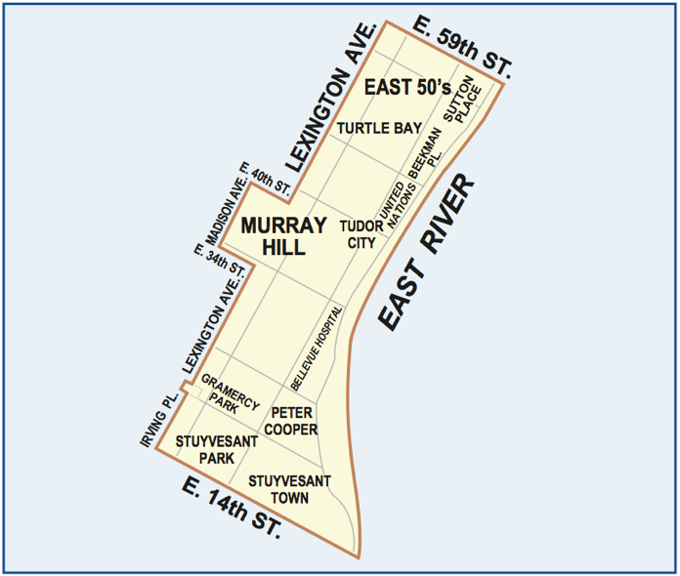
CB6
Objectives
About CB6
Analysis
Conclusion
Social Media
Tools: CardoDB
Excel
Socrata

Slide 3
Community Board Six
Located on area on the east side of Manhattan from 14th to 59th Streets, from the East River to Lexington Avenue, and extending west to Madison Avenue between 34th and 40th Streets.
Stuyvesant Town, Tudor City, Turtle Bay, Peter Cooper Village, Murray Hill, Gramercy Park, Kips Bay, Sutton Place

Slide 4
Assumption
Winter: Trash, Noise
Spring: Heat, trash, Hot water,
Summer: Noise, broken Muni Meter
Fall: Noise, Heat

Slide 5
Changing assumption
Yes, each season here is always a
noise complain
Taxi
Broken Muni meter
Illegal parking
Water system
General construction/Plumbing
Homeless person Assistance

Slide 6
Top 10 and graphs

Slide 7
Next

Slide 8
Next

Slide 9
Next

Slide 10
Diving into winter 2014 & 2013 data
the differences between the two seasons
- 2013 _ Plumbing_
-2014_ Fire Safety Director - F58­_ Vending
In 2015 maybe both

Slide 11
Heat and Hot water
Based on my data people complain the mush during December, January, February and March.
Based on the season.
https://barryi.cartodb.com/tables/table_26/map

Slide 12
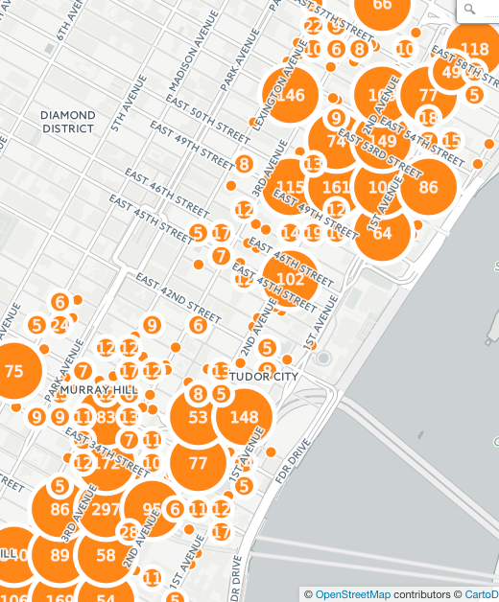
Descriptor

Slide 13
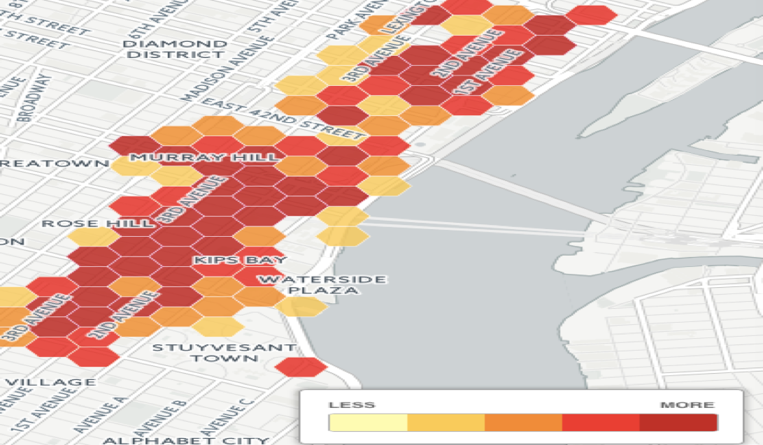
Rodent Service Requests https://barryi.cartodb.com/tables/table_24/map

Slide 14
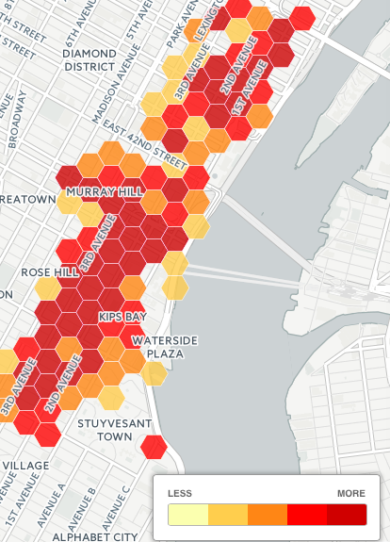
Heat map

Slide 15
Street Condition
Loud Music/Party
Loud talking
Pothole
Defective Hardware
Plate Condition _Noise

Slide 16
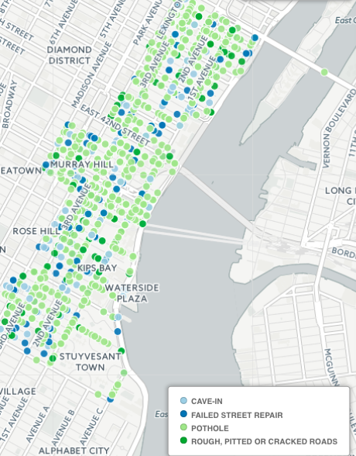
map

Slide 17
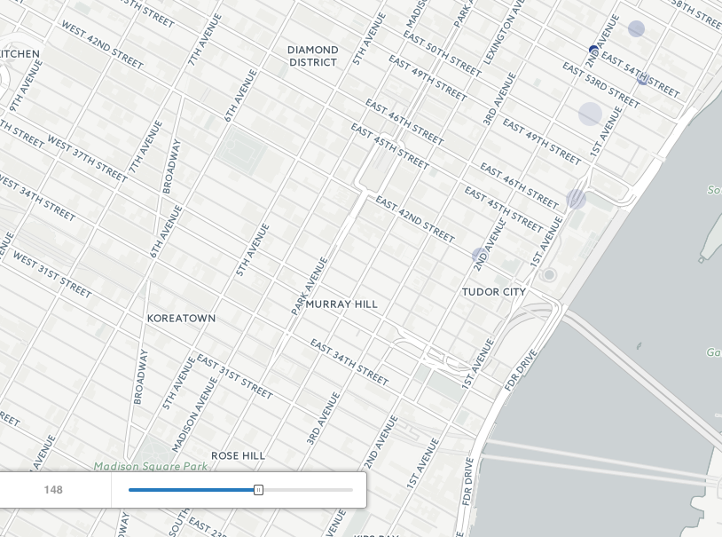
60 days real Time

Slide 18
Noise
Construction Before/After Hours (NH1)
Construction Before/After Hours (NH1)
Jack Hammering (NC2)
Loud Music/Party
Loud Talking
Barking Dog
Engine Idling
Air condition/ventilation equipment
Car/Truck Horn
Banging/Pounding

Slide 19
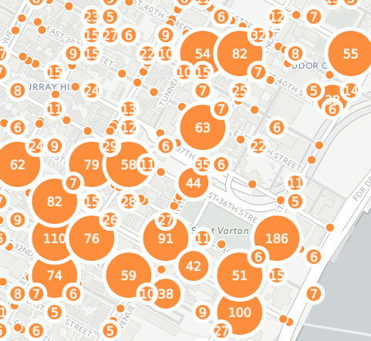
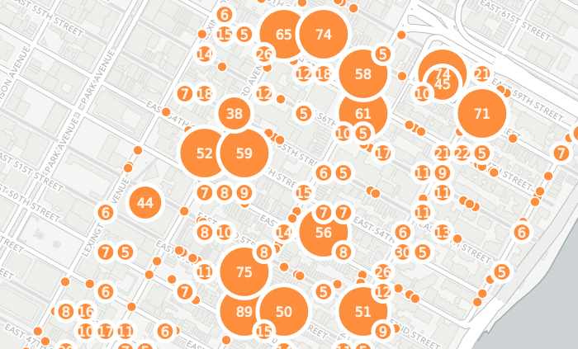
Map: https://barryi.cartodb.com/viz/5131074e-8d54-11e5-8ad5-0e8c56e2ffdb/map

Slide 20
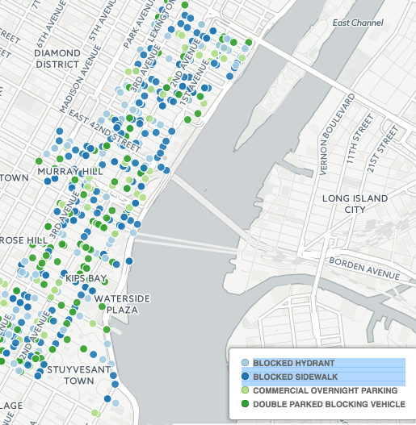
Illegal parking

Slide 21
next
https://barryi.cartodb.com/tables/illegal_parking/map

Slide 22
Conclusion
Based on my understanding CB^6 has a lotto work on because each its increasing.

